Slide 1

FREEIVA
BUY EVERYTHING FOR FREE

Slide 2

Local Products
Buy Popular Local Products At Low Price

Slide 3
What can we do on our website?
In This Site We Can Sell Many Different Type Of Products.
We Can Also Sell Some Popular Local Shops Products
There are many popular shops in our area that sell food items, creative art pieces etc.
But those shops don't distribute their products online.
We approach that vendor and tell them about our website and we list their products on our site.
So that the customers who need the item sitting at home can buy the item from our website cheaper than the store.

Slide 4
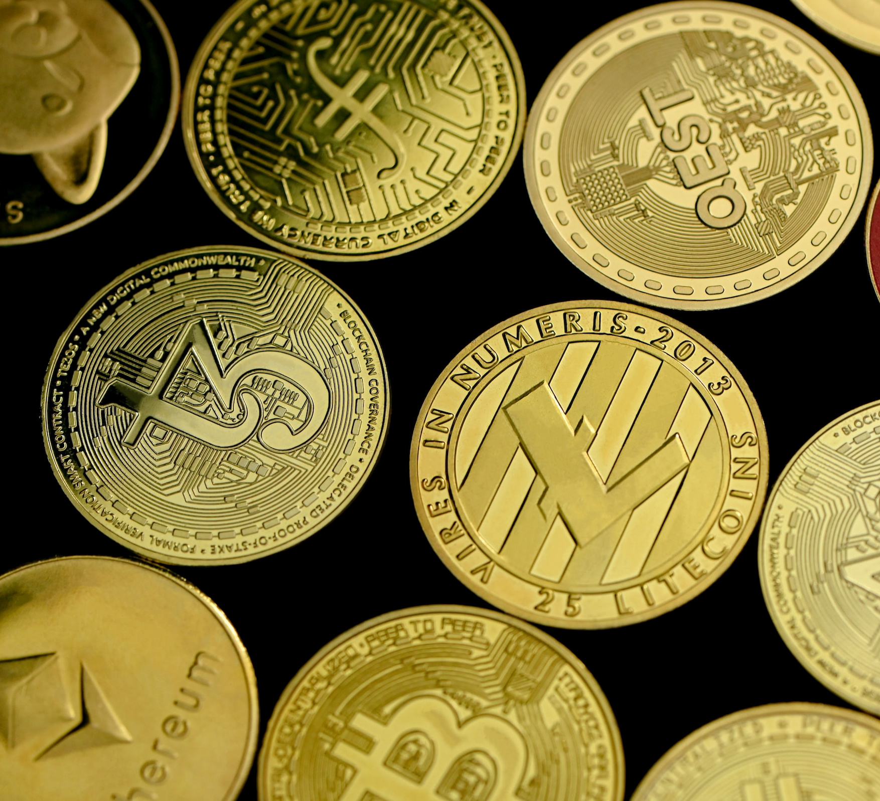
How Is Our Site Different From Others?
In Our Site We Can Add Our Money We Call Them PANA
1 PANA = 3 INDIAN RUPEE
We Sell All Items In Our Website Via PANA.
We Can Give Pana To Buyer Where They Buy Products From Us.
We Can Give Them Discount & Coupons
They Can Play Games , Watch Ads And Earn Money From Site
They Can Use That Money To Buy Products From Site

Slide 5
Pages In Site
01
Home Page
All Products In Site That Show In This Page
02
Top Sell
Top Sell Of The Week And Month They Show In This Page.
03
Play & Earn
Users Play Games Watch Ads And Earn Coins That They Can Use For Purchase Products.
04
Profile
All The User Details & Wallet show in this page.
05
About us
Details Of Support Team & Developer Show In This Page.

Slide 6




We Use This Technology
HTML & CSS
JAVASCRIPT
NMI
PHP
We Can Use Html For Describing The Structure Of Web Pages And CSS For Including Colors ,Layout And Fonts.
We Can Use JavaScript
Connect Servers To
Websites And Web Application.
We Can Use NMI For Payment Gateway Features
We Can Use PHP For Create Dynamic Content And To Interact With Database..

Slide 7
PROBLREMS WE SOLVE
Free Purchase
04
Buyer Who Don’t have money They Can Also Buy Products With PANA.
No Delivery Cost
In Our Site We Can Not Add Delivery Cost In All Products.
02
05
Local Products Available
All Things In Low Price
In Our Site We Can Add Popular Local Products That Not List In Any Other Site.
03
We Can Sell All Thing In Our Site At Low Price Compare To Other Site.
Unique Feature
That Coin Feature Is Not Available In Any Other E-commerce Site .
01

Slide 8



OUR TEAM
Patil Yash
Parmar Jayesh
Patil Kamlesh

Slide 9
THANK YOU
BUY EVERYTHING FOR FREE

